Slide 1
Applied Data Science for Rocket launching
Grégoire Hébert - 25/01/2022

Slide 2
Outline
Executive Summary
Introduction
Methodology
Results
Conclusion
Appendix

Slide 3
Executive Summary
The goal of this project is to estimate if the first stage of Falcon 9 would land successfully or not, as it plays a major role in predicting the price of its relaunch. The data for this project was sourced from SpaceX REST API, and Wikipedia. After performing some data wrangling In order to determine the best predictors for our outcome, Exploratory Data Analysis (EDA) and feature scaling were done with the help of visualization using scatter and line plots. Later some Machine Learning (ML) models were created to predict future outcomes.
The results showed that the outcome was dependent on the orbit, mass of payload, launch site, and various other technical factors such as gridfins, cores, etc.

Slide 4
Introduction
The evolution of technologies has changed the lives of people a lot, and with the current technologies, we are on the verge of building commercial space flights; which could make humans multi-planetary species. There are major companies in this space race, namely Blue Origin, Virgin Galactic, and SpaceX. The current leader in this race seems to be SpaceX, and the reason behind that is the reusability of their stage 1. This difference reduces the launch price from 165M$ (average price of their competitors) to 62M$ for SpaceX.
The problem that we are trying to answer is the following : how can we predict the launch price of Falcon 9, so that we can use this data for companies that want to compete with SpaceX? Predicting whether stage 1 will land successfully or not plays a crucial role in predicting the launch price. There are many variables involved, and we need to predict which one are crucial for reusing this stage 1.

Slide 5
Section 1 : Methodology

Slide 6
Methodology step by step :
Data collection methodology :
The data was collected from SpaceX REST API and from Wikipedia, using BeautifulSoup to perform web scraping and retrieve these data
Data wrangling steps :
The null values were handled by replacing them with the mean value
One-hot encoding was done on categorical variables such as orbit, launch site, landing pad and serial.
Exploratory Data Analysis (EDA), using visualization and SQL
Creation of interactive visual analytics, using Folium and Plotly Dash
Performing predictive analysis using classification models
Using various Machine Learning models like SVM, logistic regression, tree classifier and k nearest neighbours

Slide 7
Step 1 : Data Collection
The first datasets were collected directly from the SpaceX REST API : https://api.spacexdata.com/v4/launches/past
→ This dataset provides data like type of rocket used, payload, launch / landing specifications, landing outcome, for each launch.
Data was also collected via web scraping, using BeautifulSoup, as the list of Falcon 9 and Falcon Heavy launches is available online on Wikipedia : List of Falcon/ 9/ and Falcon Heavy launches - Wikipedia

Slide 8
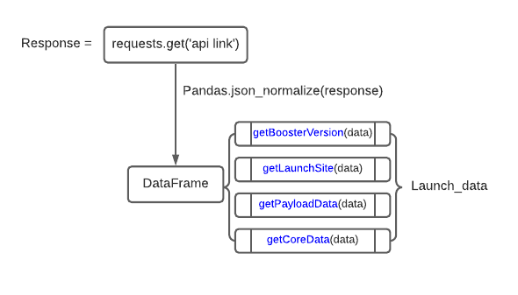
Step 1 : Data Collection using SpaceX REST API
First a request object was created using the API.
The response object was converted into a dataframe using pandas.json_normalize(response.json())
For the complete code and output, please follow the Github link below: https://github.com/Greg156/IBM-Data-Science-Final-Project-SpaceX-/blob/main/spacex-data-collection-api.ipynb

Slide 9
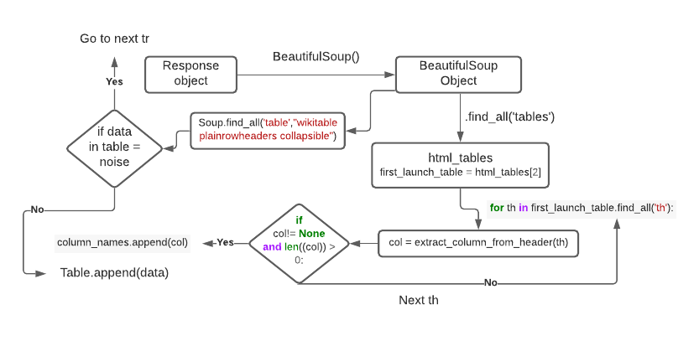
Step 2 : Web scraping through Wikipedia
Thanks to the BeautifulSoup framework, we were able to collect data directly from a Wikipedia page. Here is the coding process :
For the complete code and output, please follow the Github link below: https://github.com/Greg156/IBM-Data-Science-Final-Project-SpaceX-/blob/main/spacex-webscraping.ipynb

Slide 10
Data wrangling
The original dataset contained Falcon 1 and Falcon 9 launches ; we first filtered it to keep only the Falcon 9 data.
Then we adressed the missing values on two columns:
When “PayloadMass” was missing, we replaced it by the mean value
When “Landingpad” was missing we left a null value, because it meant that no landing pad were used.
We used one-hot encoding to represent some categorical data into binary vectors (failure = 0, success = 1) and be able to “feed” them into ML algorithms. Thanks to this, we found out that the success rate was 66%.
For the complete code and output, please follow the Github link below: https://github.com/Greg156/IBM-Data-Science-Final-Project-SpaceX-/blob/main/Data%20Wrangling.ipynb

Slide 11
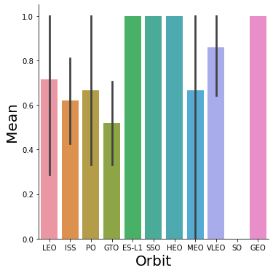
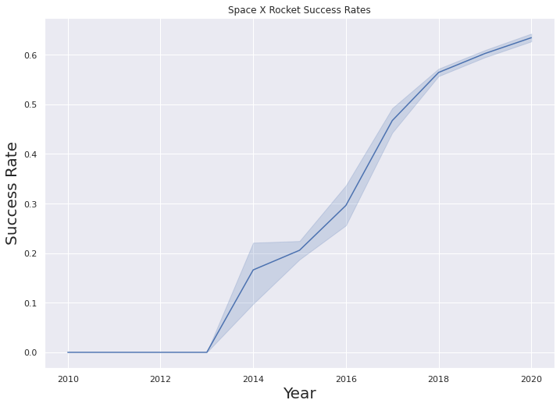
Exploratory Data Analysis (EDA) with Data Visualisation
We created some bar and line graphs to show how variable relates one to another.
Bar Graph : Mean vs Orbit
Line Graph : Success Rate vs Year
For the complete code and output, please follow the Github link below: https://github.com/Greg156/IBM-Data-Science-Final-Project-SpaceX-/blob/main/eda-dataviz.ipynb

Slide 12
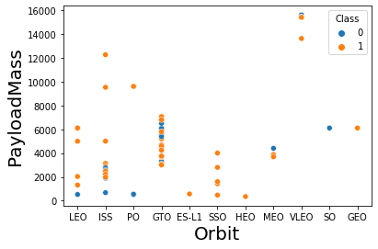
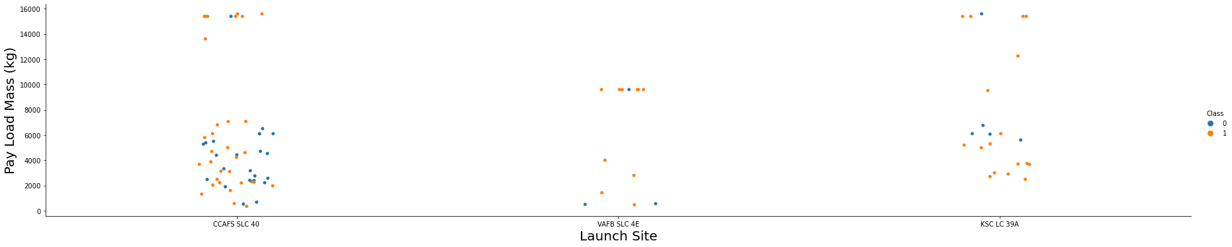
EDA with Data Visualisation
We also created some scatter plots to understand better our data.
Flight number vs PayloadMass
Flight number vs Launch Site
PayloadMass vs Launch Site
Orbit vs Flight number
Payload vs Orbit Type
For the complete code and output, please follow the Github link below: https://github.com/Greg156/IBM-Data-Science-Final-Project-SpaceX-/blob/main/eda-dataviz.ipynb

Slide 13
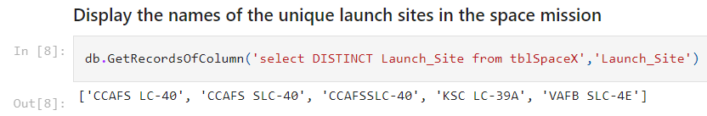
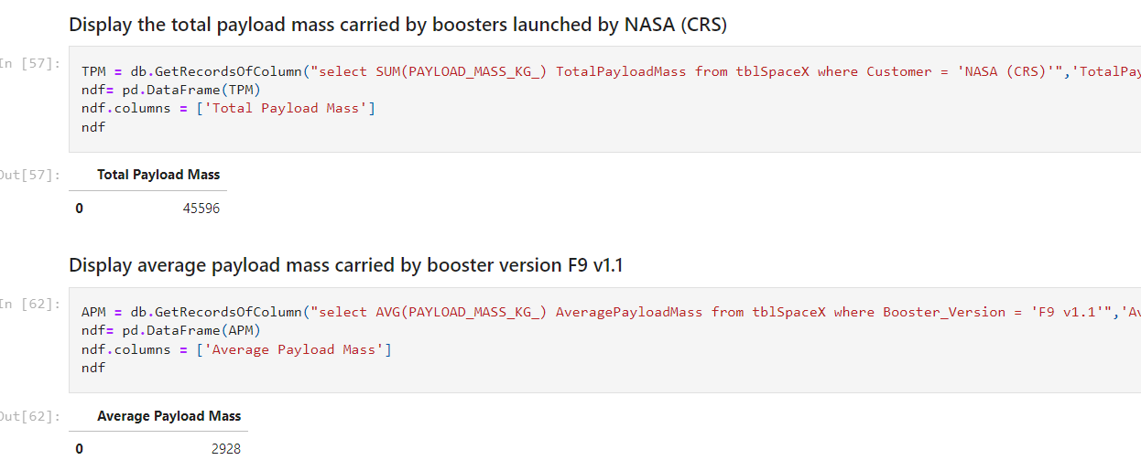
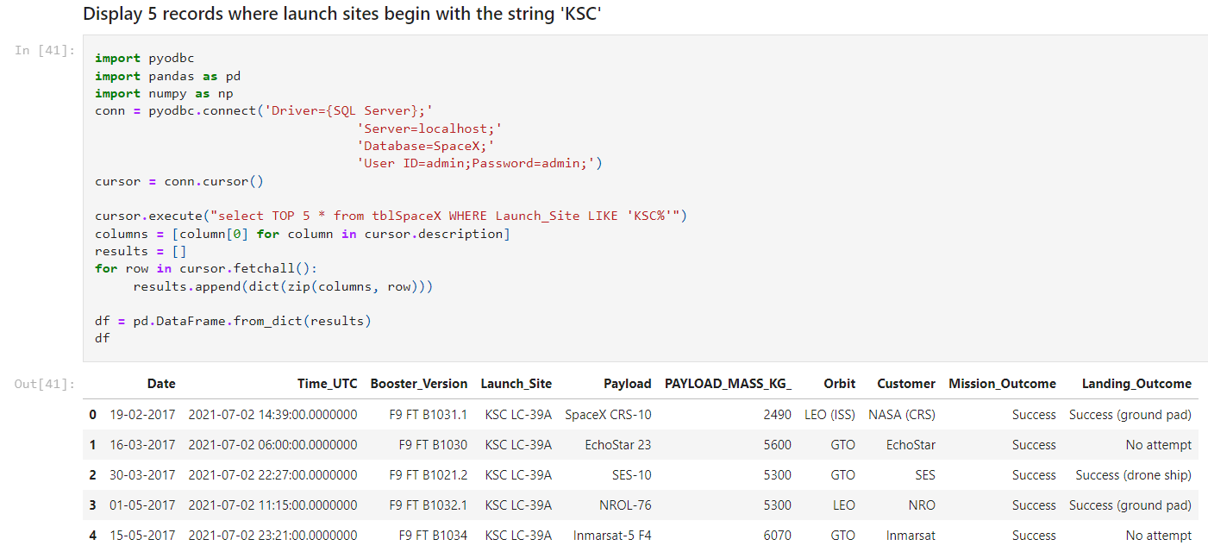
EDA with SQL
We performed SQL queries to gather information about our dataset. Here are the information we extracted :
For the complete code and output, please follow the Github link below: https://github.com/Greg156/IBM-Data-Science-Final-Project-SpaceX-/blob/main/EDA%20SQL.ipynb

Slide 14
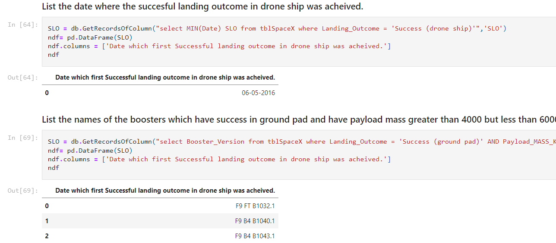
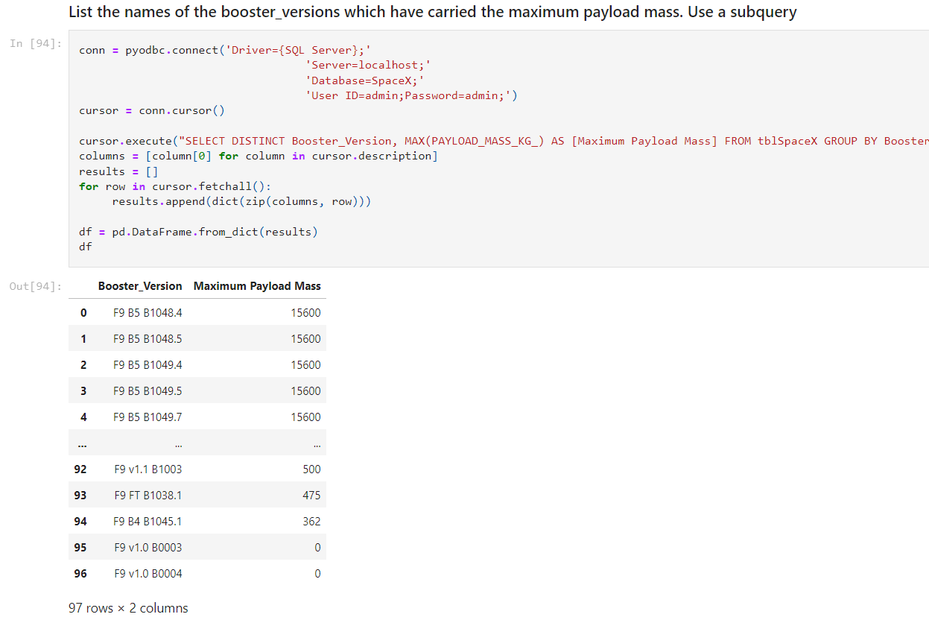
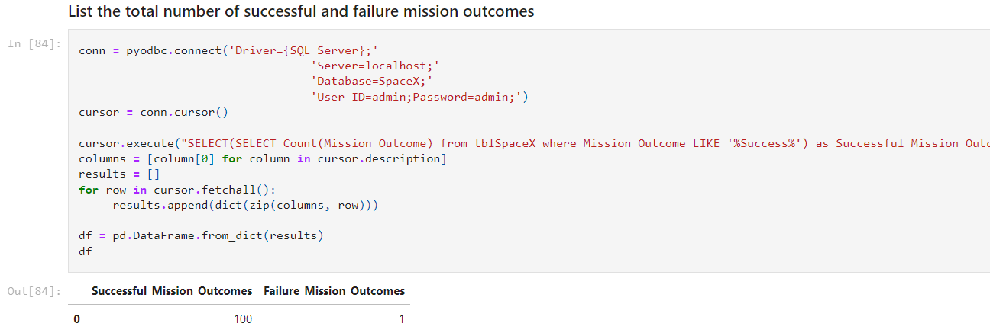
EDA with SQL
We performed SQL queries to gather information about our dataset. Here are the information we extracted :
For the complete code and output, please follow the Github link below: https://github.com/Greg156/IBM-Data-Science-Final-Project-SpaceX-/blob/main/EDA%20SQL.ipynb

Slide 15
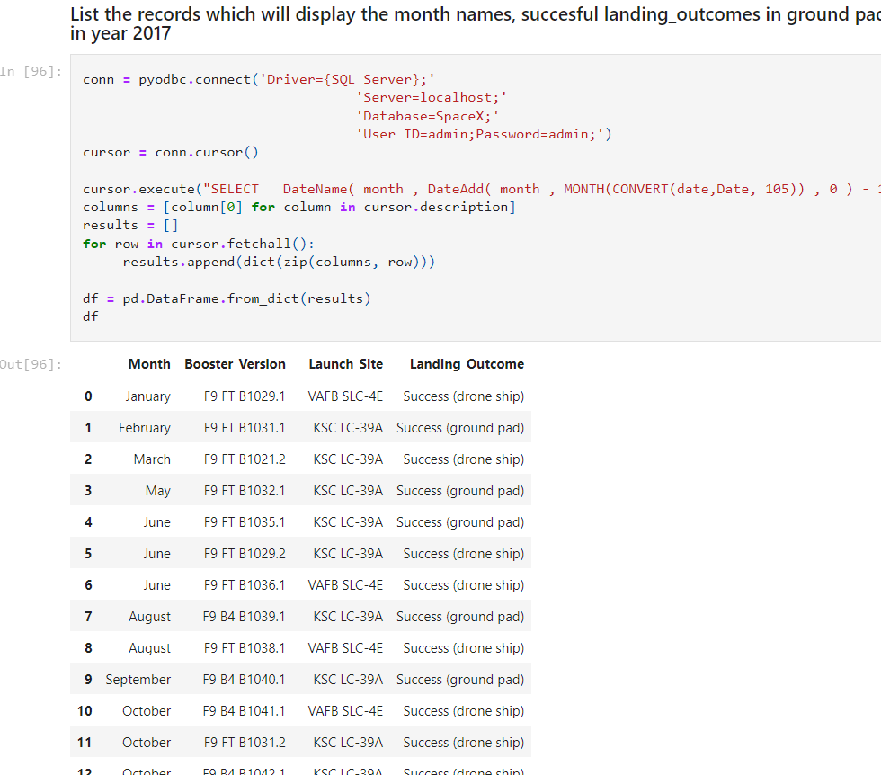
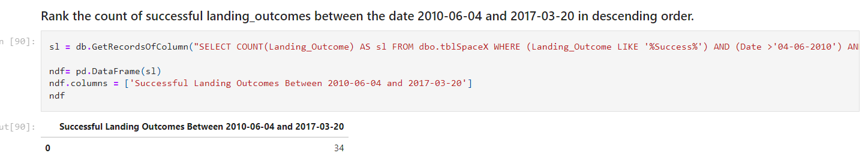
EDA with SQL
We performed SQL queries to gather information about our dataset. Here are the information we extracted :
For the complete code and output, please follow the Github link below: https://github.com/Greg156/IBM-Data-Science-Final-Project-SpaceX-/blob/main/EDA%20SQL.ipynb

Slide 16
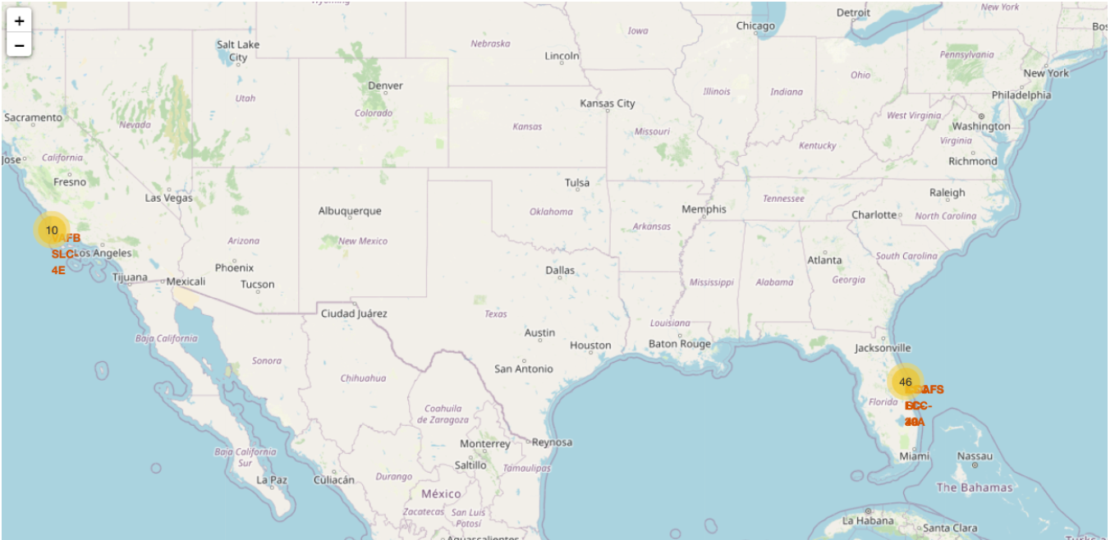
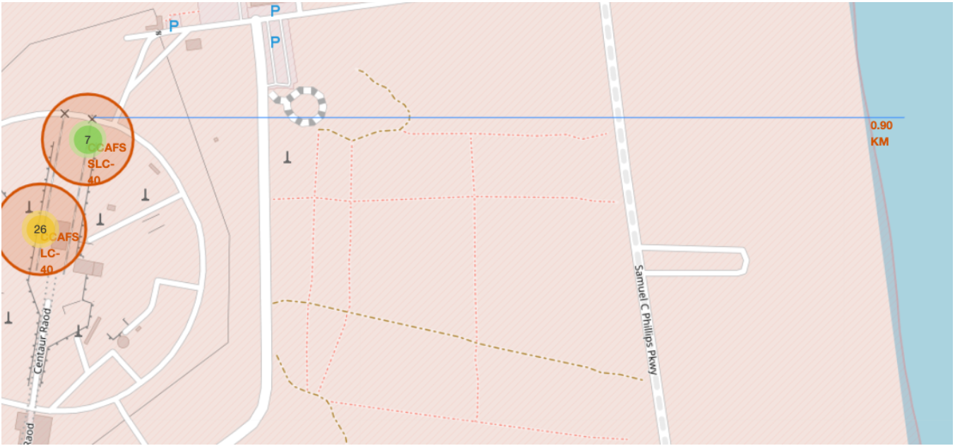
Interactive Map with Folium
In order to visualize the data on an interactive map, we used different types of markers, highlighted circles, etc. for each different launch sites. Cluster objects were created to visualize the launch outcomes :
0 = red = unsuccessful
1 = green = successful
We also added a polyline object to show distance (calculated using Haversine’s formula) between the launch site and various landmarks such as railways, highways, etc.
For the complete code and output, please follow the Github link below: https://github.com/Greg156/IBM-Data-Science-Final-Project-SpaceX-/blob/main/Interactive%20folium%20map

Slide 17
Flask / Plotly Dash dashboard
An interactive web application was created using Dash, with a drop-down menu to select the launch site, and range-slider to choose the range of payload.
Interactive pie chart showing success rate of all launch sites by default, and a scatter plot showing launch outcomes of all sites according to their payloads in the default range(0-10000) were added.
Dropdown menu would allow the user to choose the launch site that would alter the figure of pie chart and scatter plot to show outcomes of that launch site, and through the range-slider user can select the range of payload on the x-axis of scatter plot. These interactions would allow the user to visualise the data more in depth according to his needs.
For the complete code and output, please follow the Github link below: https://github.com/Greg156/IBM-Data-Science-Final-Project-SpaceX-/blob/main/Dashboard%20SpaceX%20Dataset.ipynb

Slide 18
Predictive Analysis (Classification)
We used several types of Machine Learning (ML) models to try and predict the outcome of new launches, based on existing data. We used :
logistic regression
SVM
decision tree
KNN
After building, training, evaluating the performance and improving our different models, we evaluated the predictive performance of each models to find the best one. In the end, the best was KNN with a R² of 0.83.
For the complete code and output, please follow the Github link below: https://github.com/Greg156/IBM-Data-Science-Final-Project-SpaceX-/blob/main/machine-learning-prediction-spacex.ipynb

Slide 19
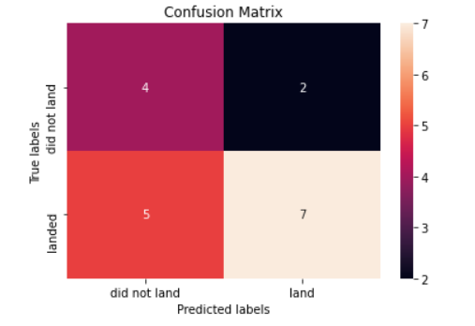
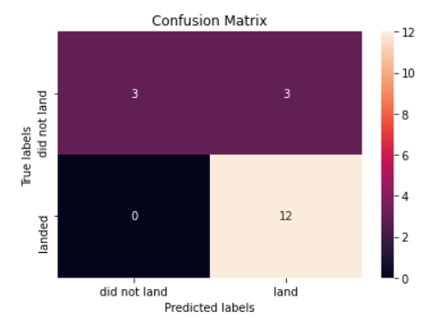
Predictive Analysis (Classification) : Results
Confusion matrix of the tree algorithm on the test data :
Confusion matrix of the KNN algorithm on the test data :
We can see that KNN classified with a better accuracy : for example there are no false negatives (when the model predicted it would not land, it really did not land in reality).
For the complete code and output, please follow the Github link below: https://github.com/Greg156/IBM-Data-Science-Final-Project-SpaceX-/blob/main/machine-learning-prediction-spacex.ipynb

